Slide 1
IBM Attrition Case Study
Team Members:
Jeffery Chan
Sze Wing Leung

Slide 2
Problem Statement
Attrition is becoming an increasing concerns to business of all sizes
Employee is backbone of any organization, especially tech industry, and employee attrition can incur big cost to business, like loss of innovation, morale, productivity, cost of time, money, resources in hiring and retraining new talents .
. Employee turnover is regarded as the key issue for all organizations these days, because of its adverse effects on workplace productivity, and accomplishing organizational objectives on time [2]. In order for an organization to continually have a higher competitive advantage over its competition, it should make it a duty to minimize employee attrition Therefore, for the better development of corporation, it is essential for the leader of companies to know the main reasons why their employees choose to leave the company,then take relevant measures to improve their company’s productivity, overall workflow and business performance.
Our aim: We want to study what are the relevant factors (features) in our dataset and create machine learning model to predict whether an IBM employee will leave the company or not so that we can advise the HR department on what actions to take to minimize attrition.

Slide 3
Workflow
Data Preparation & Understanding
Feature Engineering/Selection
Feature Scaling
Class Imbalance Fix
Model Fitting
Model Comparision
Recommendations & Conclusion
Q&A

Slide 4
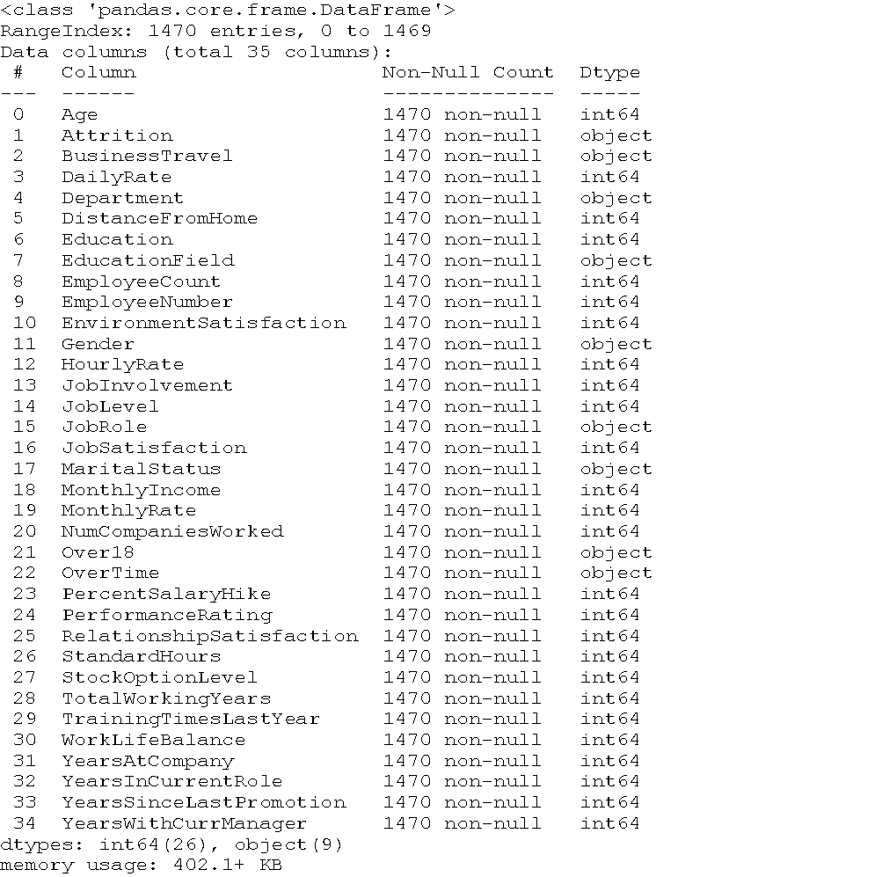
Data Preparation & Understanding
First look view at overall structure of
our dataset
1470 observations
35 features
Cleaned dataset
Categorical: business travel, department,
Education, gender, martial status…

Slide 5
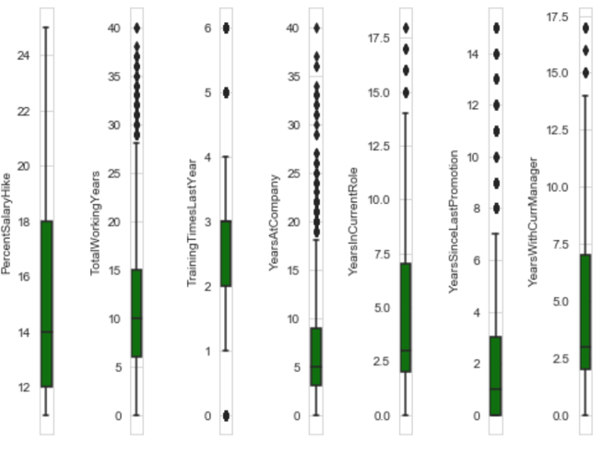
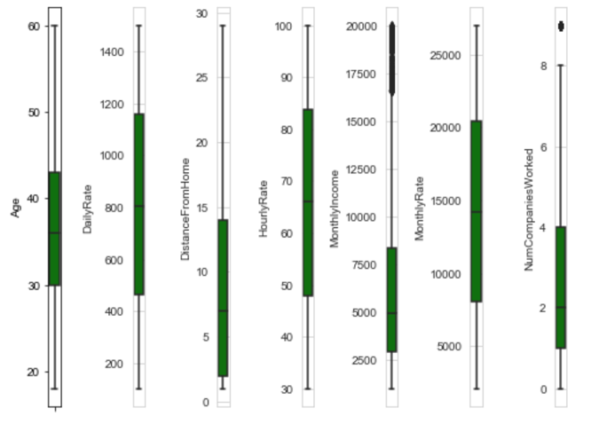
Anamoly Detection
One way to counter this problem is by feature scaling the variables so as to reduce its effect on the model.

Slide 6
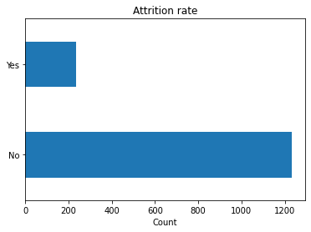
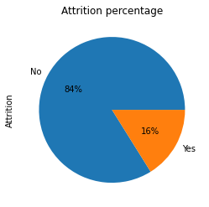
Target distribution
Imbalanced dataset presents skewness/bias to our test accuracy and thus negatively impact our model predictions and needs fix before train/test split

Slide 7
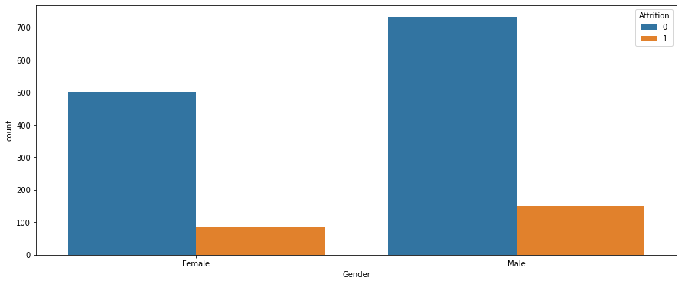
Univariate Analysis
Observation: Male is more likely to churn than female counterpart

Slide 8
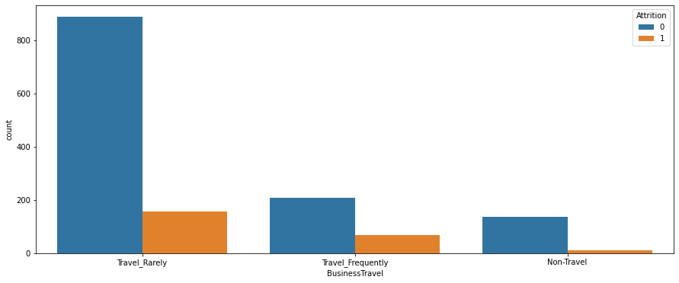
Univariate Analysis
Observation: The workers who travel rarely are more likely to quit then other employees.

Slide 9
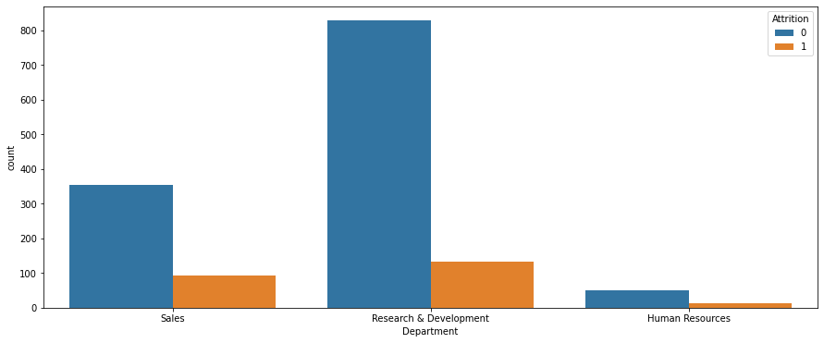
Univariate Analysis
Observation: R&D and Sales Department personnel are more likely to quit

Slide 10
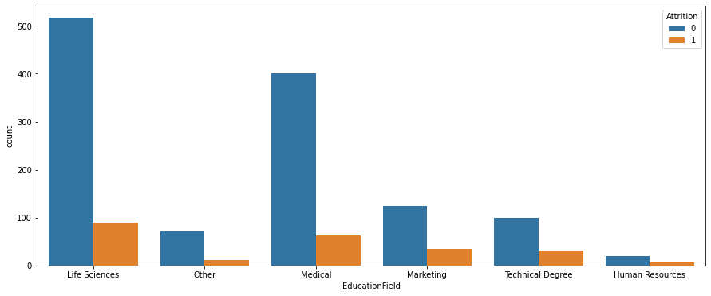
Univariate Analysis
Observation: Life Sciences & Medical Degree have high attrition rates

Slide 11
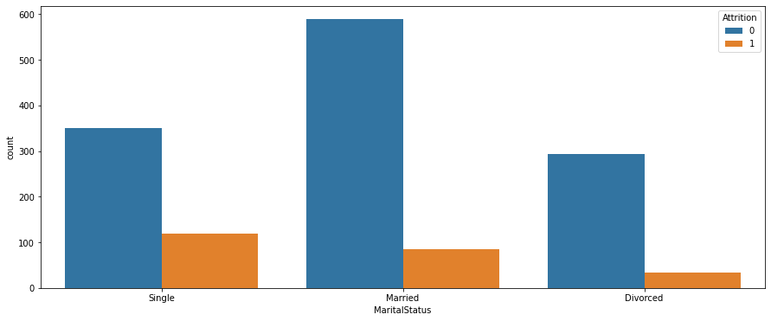
Univariate Analysis
Observation: The workers who have Single marital status are more likely to quit the Married, and Divorced.

Slide 12
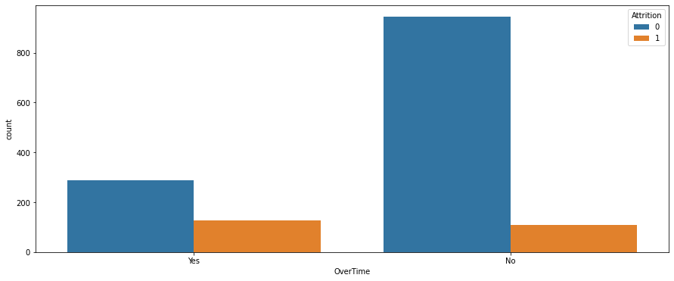
Univariate Analysis
Observation: Employees who work over time have high attrition than employees who did not do over time

Slide 13
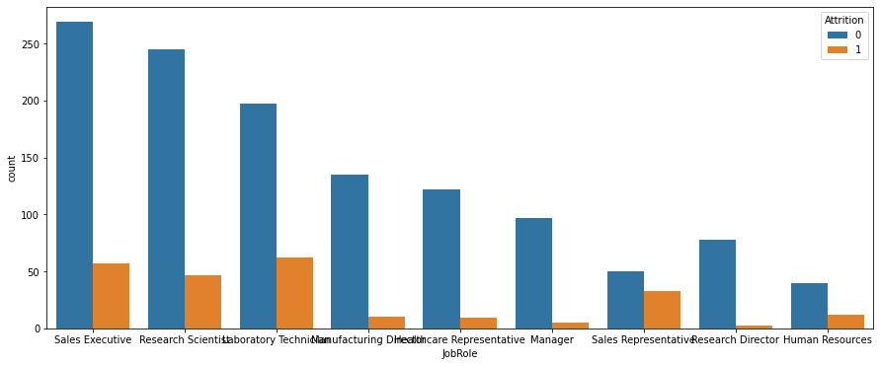
Univariate Analysis
Observation: Sales & Technical roles are likely to churn

Slide 14
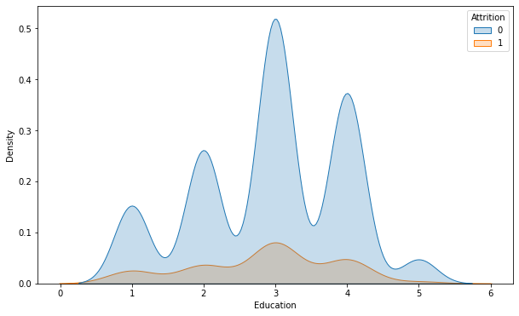
Univariate Analysis
Observation: Bachelors have highest probability of churn.

Slide 15
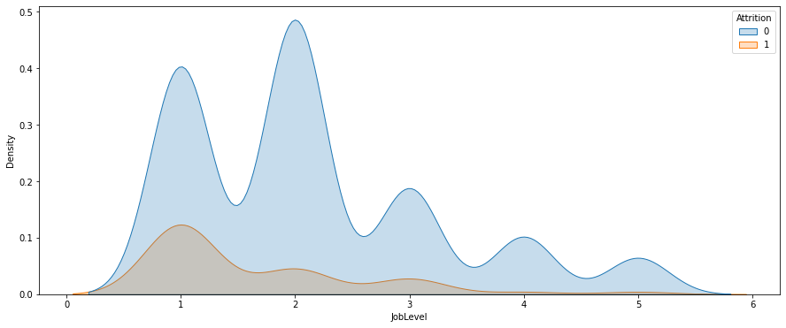
Univariate Analysis
Observation: The workers with low JobLevel are more likely to quit there jobs

Slide 16
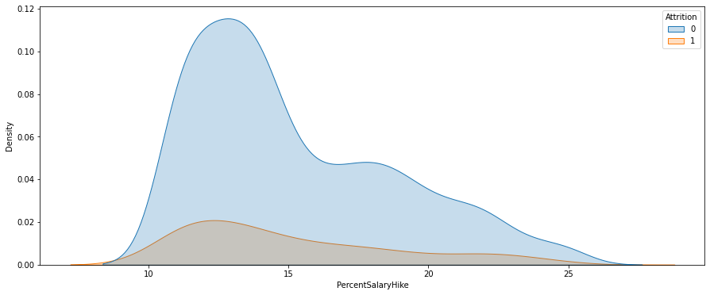
Univariate Analysis
Observation: Higher hikes motivate people to work better, and stay in the organization.

Slide 17
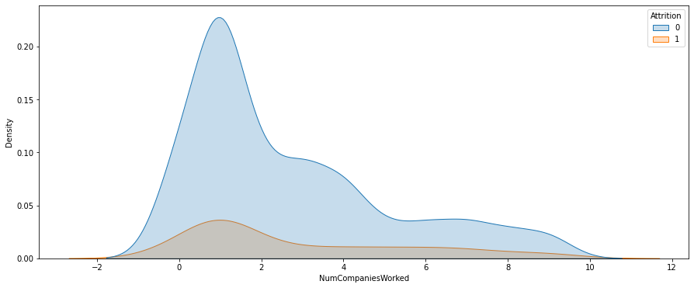
Univariate Analysis
Observation: employees who started their career with the company- or have switched to the company in the initial years of their career, have a higher chances of leaving the organization to a different company.

Slide 18
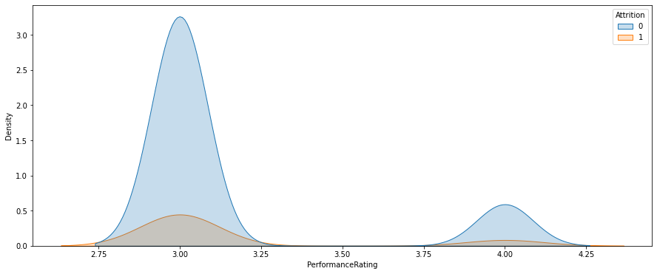
Univariate Analysis
Observation: Lower performance rating/feedback from managers may cause employees to quit their job.

Slide 19
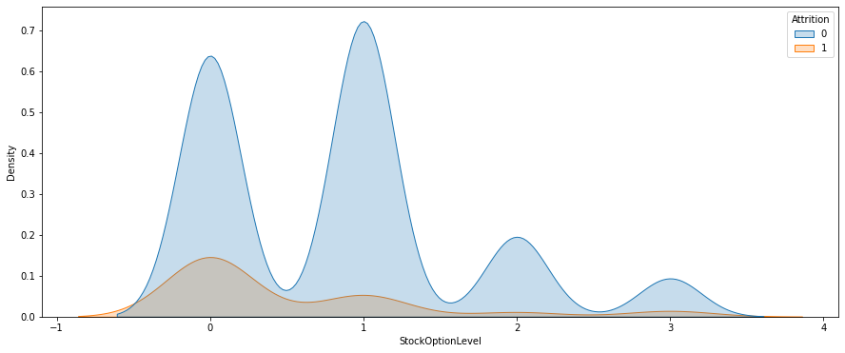
Univariate Analysis
Observation: Stock option comprise large portion of pay, no financial incentive to stay

Slide 20
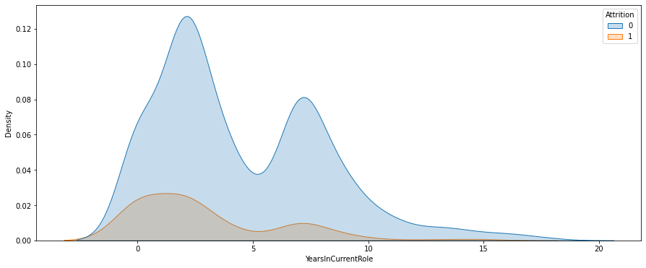
Univariate Analysis
Observation: Employees who don’t get promotion with 1-2 years tend to quit the company.

Slide 21
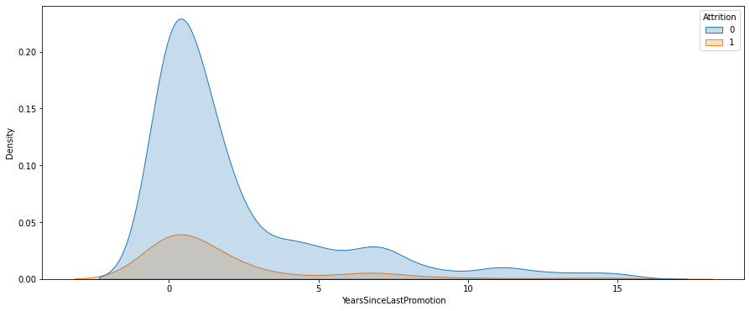
Univariate Analysis
Observation: Colleagues tend to move on to a new company 1-2 years after promotion.

Slide 22

Univariate Analysis
Observation: Fresh colleagues may have issues with senior counterparts, leaving company prematurely.

Slide 23
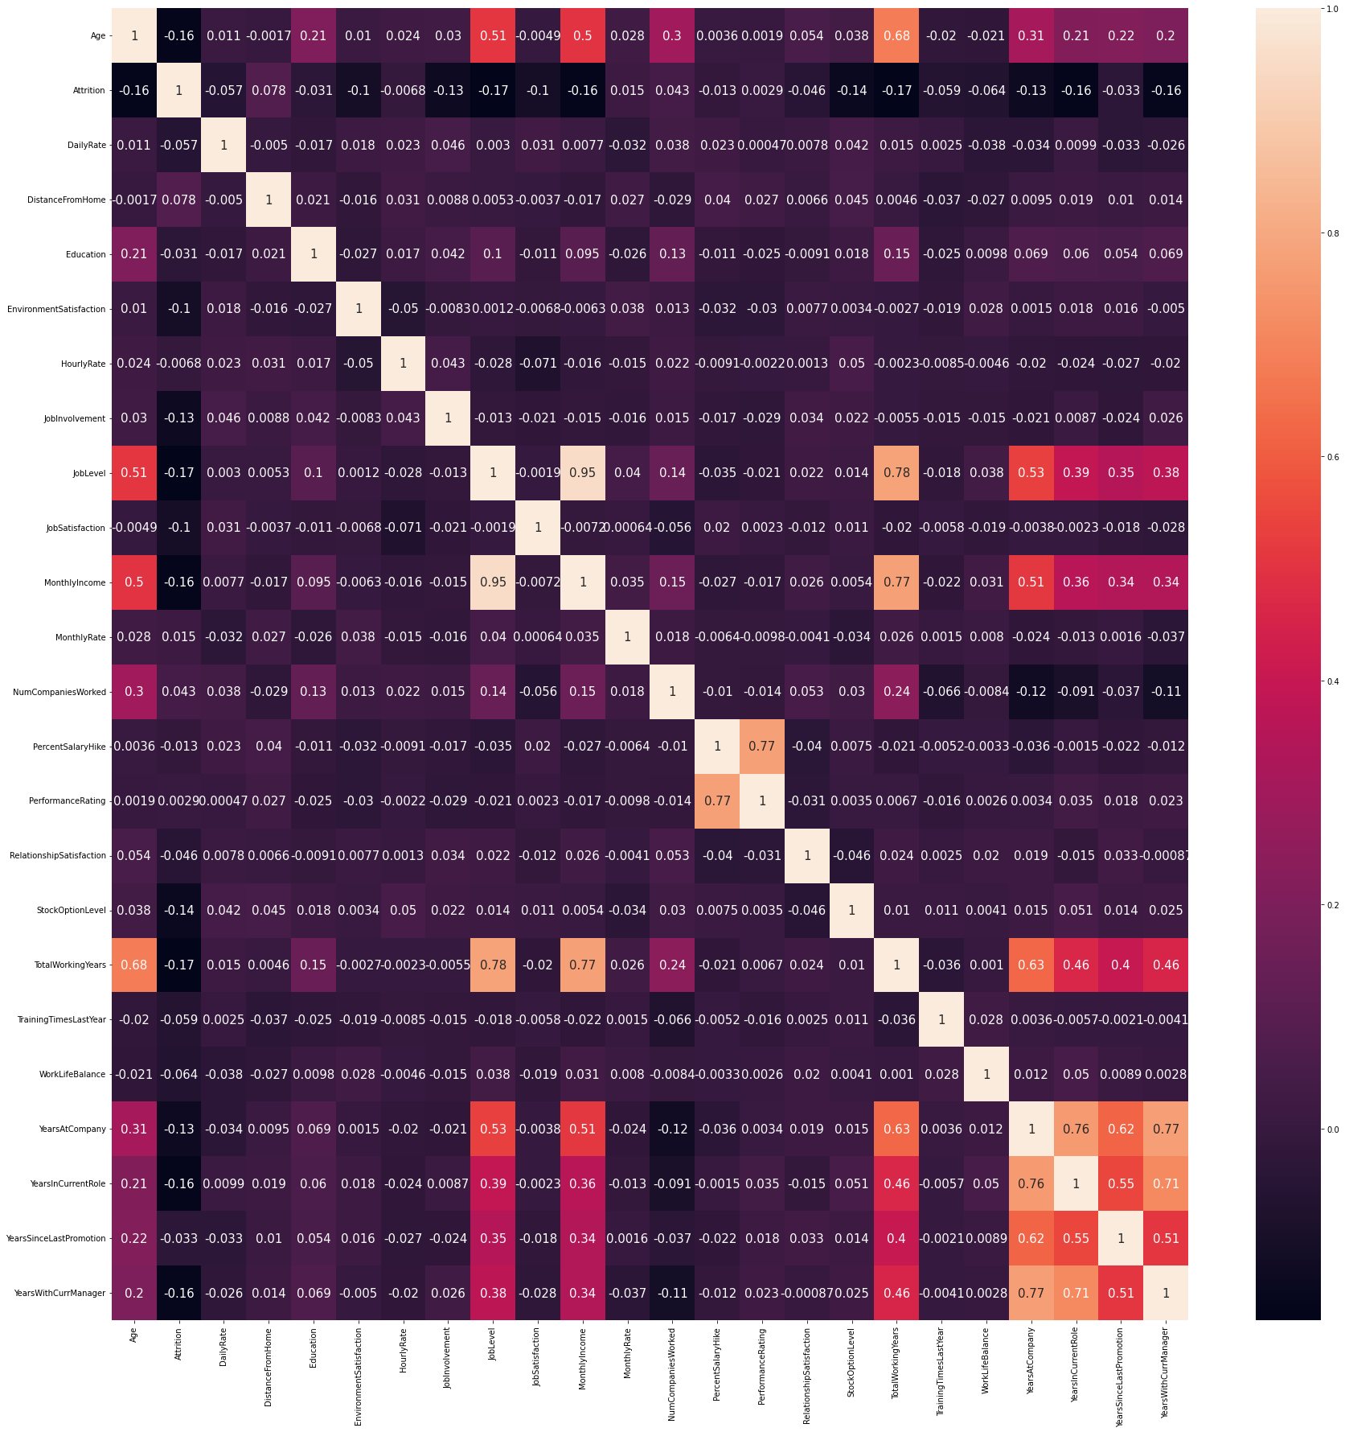
Bivariate Analysis
A rule of thumb that is followed for multi collinearity is if correlation coefficient (r) is close to 0.80.
Correlation between MonthlyIncome and JobLevel is 0.95. This is a very high correlation.
Correlation between TotalWorkingYears and JobLevel is 0.78 which is also very close to 0.80.

Slide 24
Feature Engineering/Selection
Employee Count
Over18:
StandardHours
EmployeeNumber
Multicollinearity
JobLevel: 0.95 correlation coefficient with MonthlyIncome
And 0.78 with TotalWorkingYears.
TotalWorkingYears: 0.77 correlation with MonthlyIncome.

Slide 25
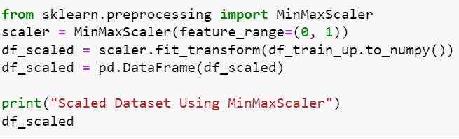
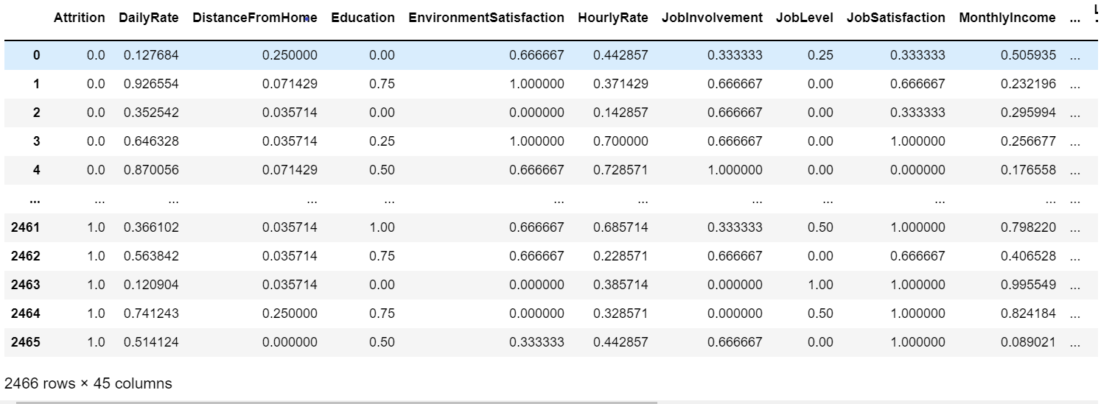
Feature Scaling

Slide 26
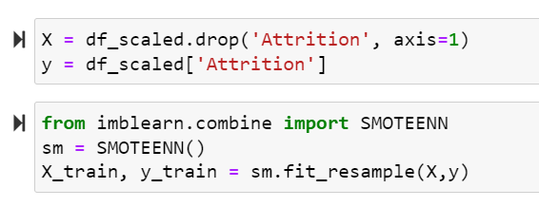
Class Imbalance Fix (SMOTE)
Apply SMOTE-ENN

Slide 27
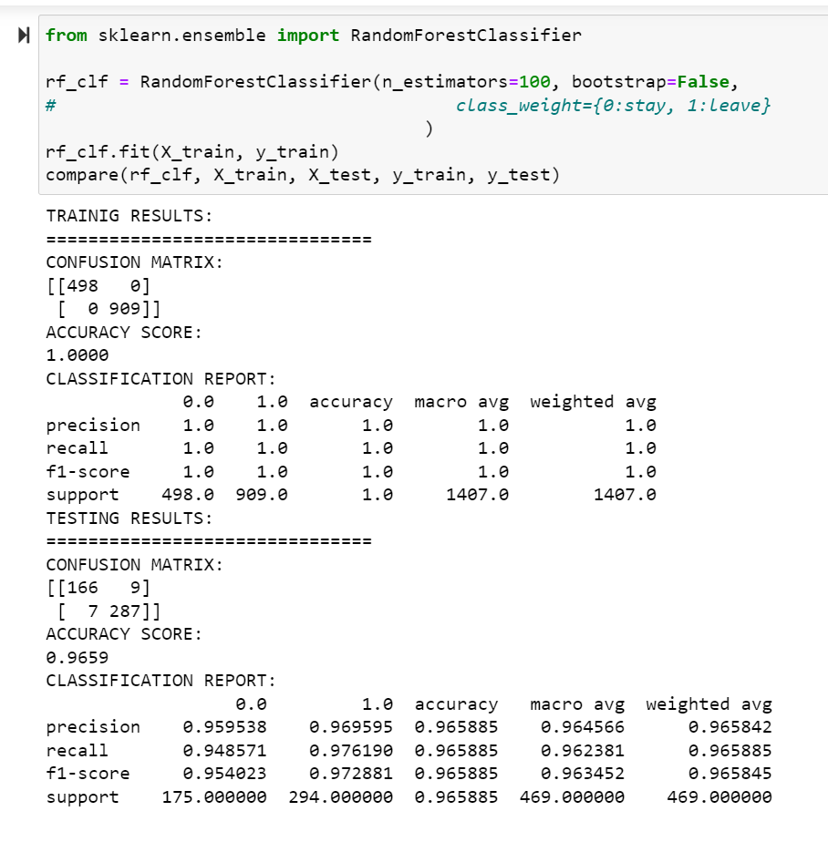
Random Forest- Model Fitting
Accuracy of the training data set : 1
Accuracy of the testing dataset : 0.96
Precision, recall ,f1-score ~ 0.96-0.97

Slide 28
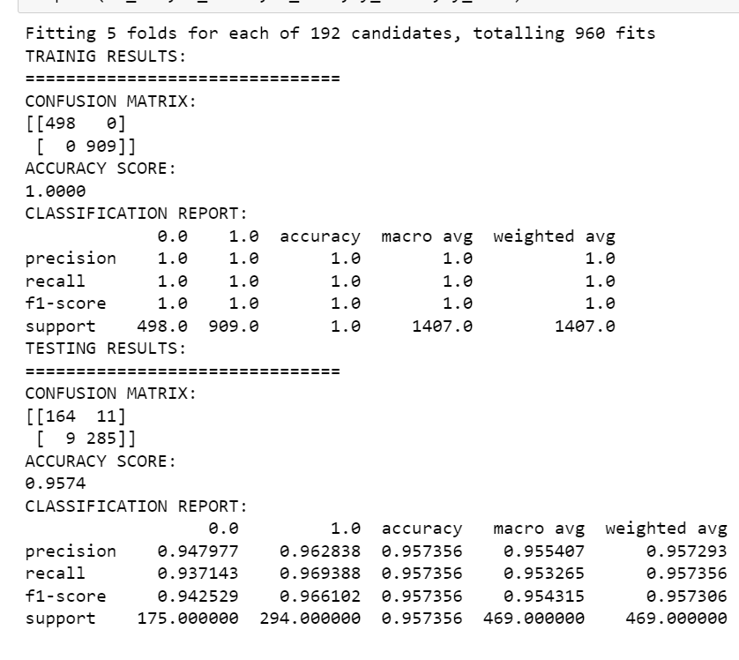
Random Forest- Hyperparameter Tuning
A decrease in accuracy
Hyperparameter tuning only works if the set of customized parameters is better than the default setup.

Slide 29
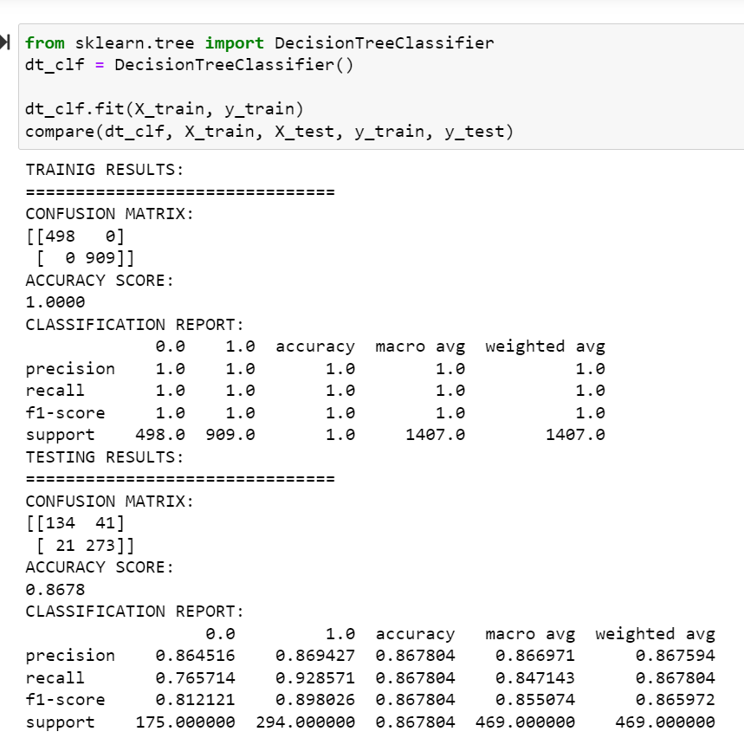
Decision Tree-
Model Fitting
Training Accuracy : 1
Testing Accuracy: 0.86

Slide 30
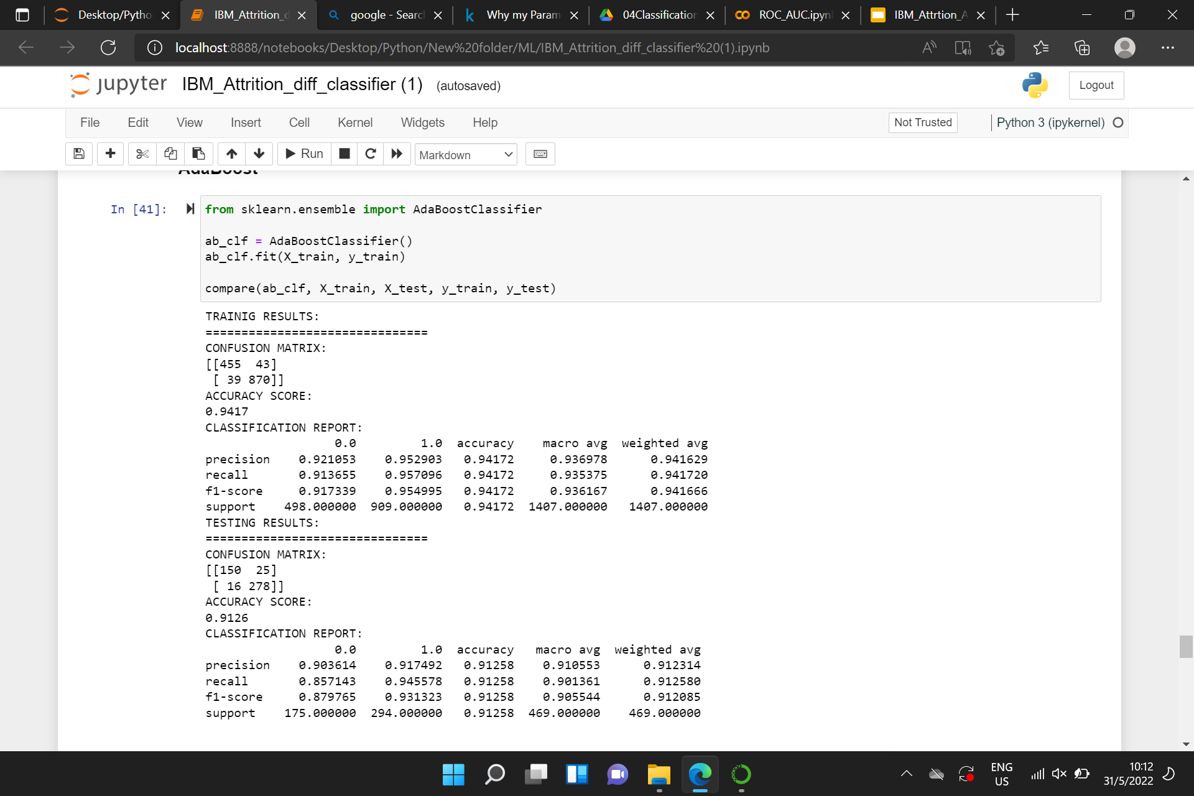
AdaBoost-
Model Fitting
Training accuracy: 0.94
Testing accuracy: 0.91

Slide 31
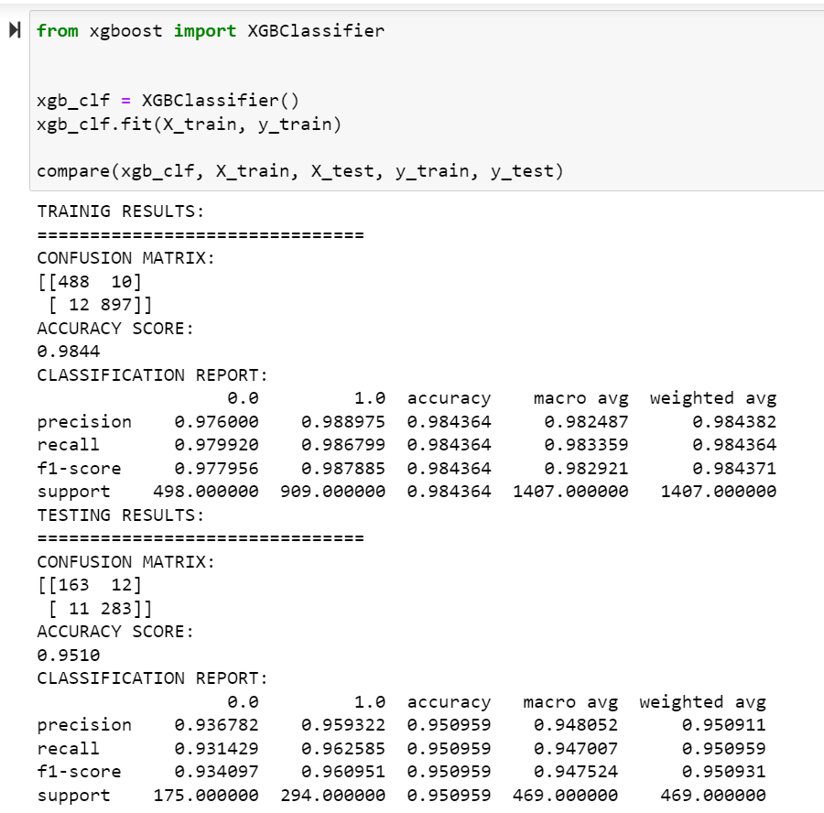
XgBoost-
Model Fitting
Training accuracy: 0.98
Testing accuracy: 0.95

Slide 32
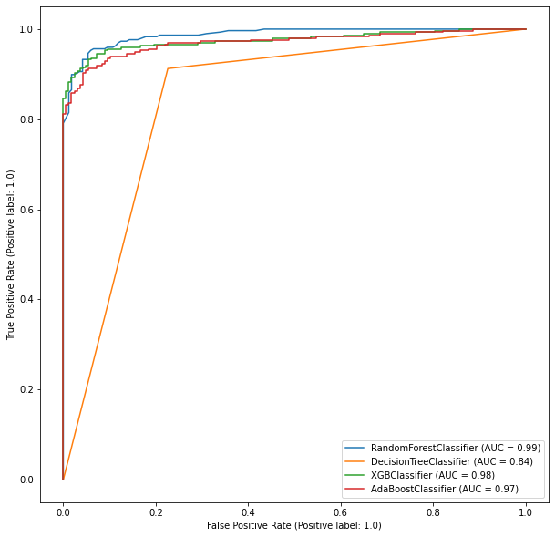
Model Comparision

Slide 33
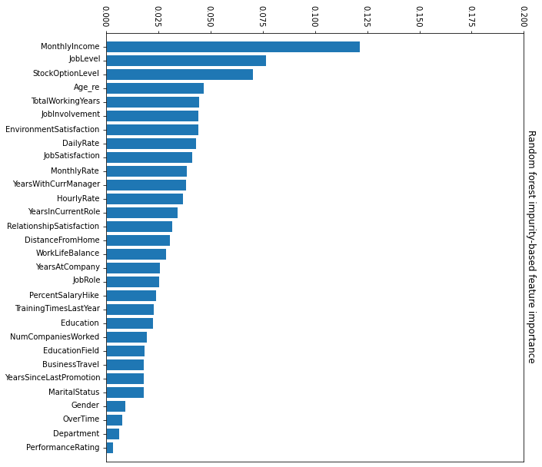
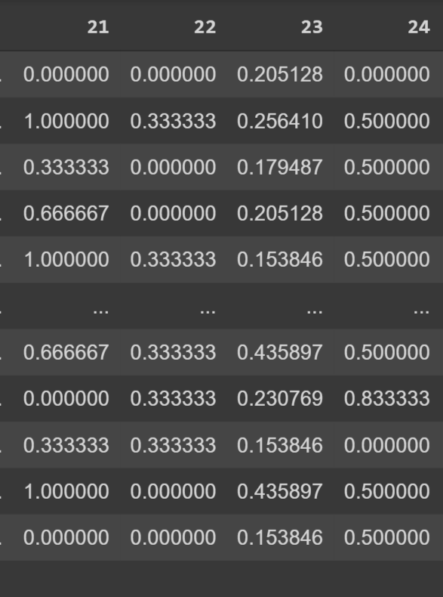
Recommendations & Conclusion
Random forest impurity-based feature importance
How much the performance will drop if we shuffled the column

Slide 34
Recommendations & Conclusions
The HR Department can focus on the important variables that contribute significantly in determining if an employee is going to leave an organization. Such variables are:
· Monthly Income
· Job Level
· Stock Optimal Level
· Total Working Years
· Job Involvement
Based on the above variables, one can clearly notice a pattern. The employees are more concerned with the materialistic objects that they get directly in hand. Then comes the psychological variables that determines if an employee might leave the organization.
Hence, the HR can focus on such aspects and understand from the viewpoint of the employees.

Slide 35
Q&A
Questions or comments?

